Slide 1

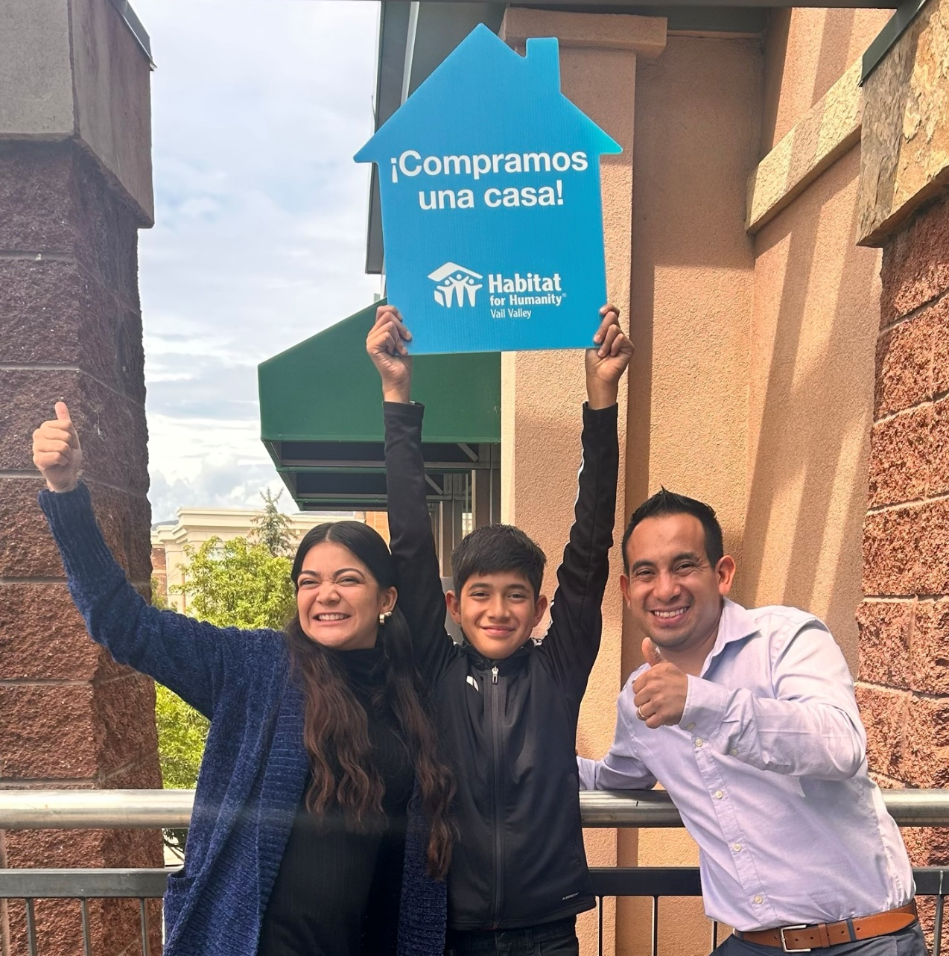
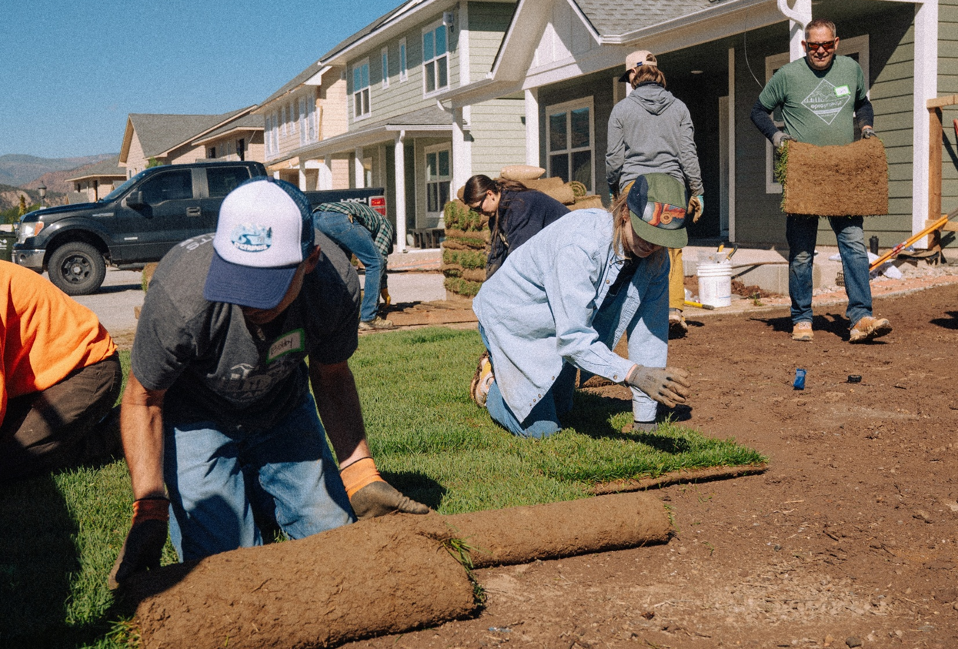
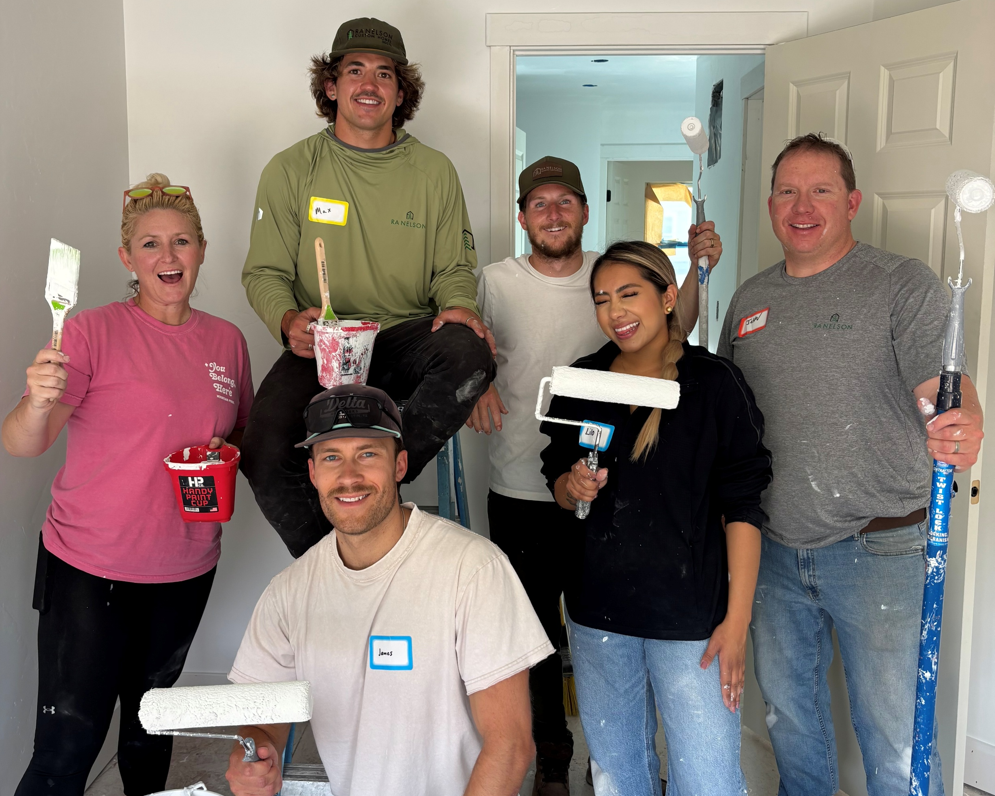
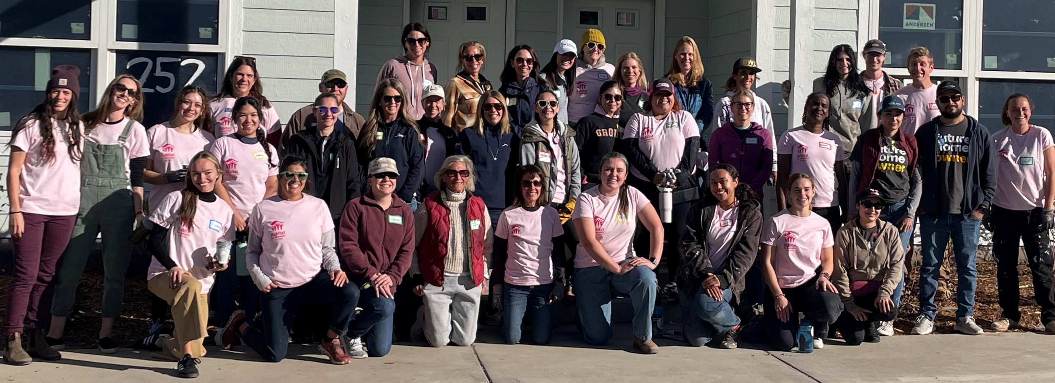
On the Jobsite
2025 WRAPS WITH LOTS OF HIGHS
8 STRATTON FLATS
1 HOME RENOVATED
NEW CONSTRUCTION
HOMES COMPLETED
Stratton Flats Homeowners Celebrate Closing on their Habitat home
41
COMMUNITY GROUPS AT STRATTON FLATS
Vail Resorts volunteers roll out sod
4 DAYS OF VAIL RESORTS WEEK
2 DAYS OF WOMEN BUILD
RA Nelson volunteers painting walls!
Women Build volunteers
Habitat for Humanity Vail Valley | 970.748.6718
Construction | 970.748.6718 ext. 305
Habitat ReStore | 970.328.1119
construction@habitatvailvalley.org

Slide 2
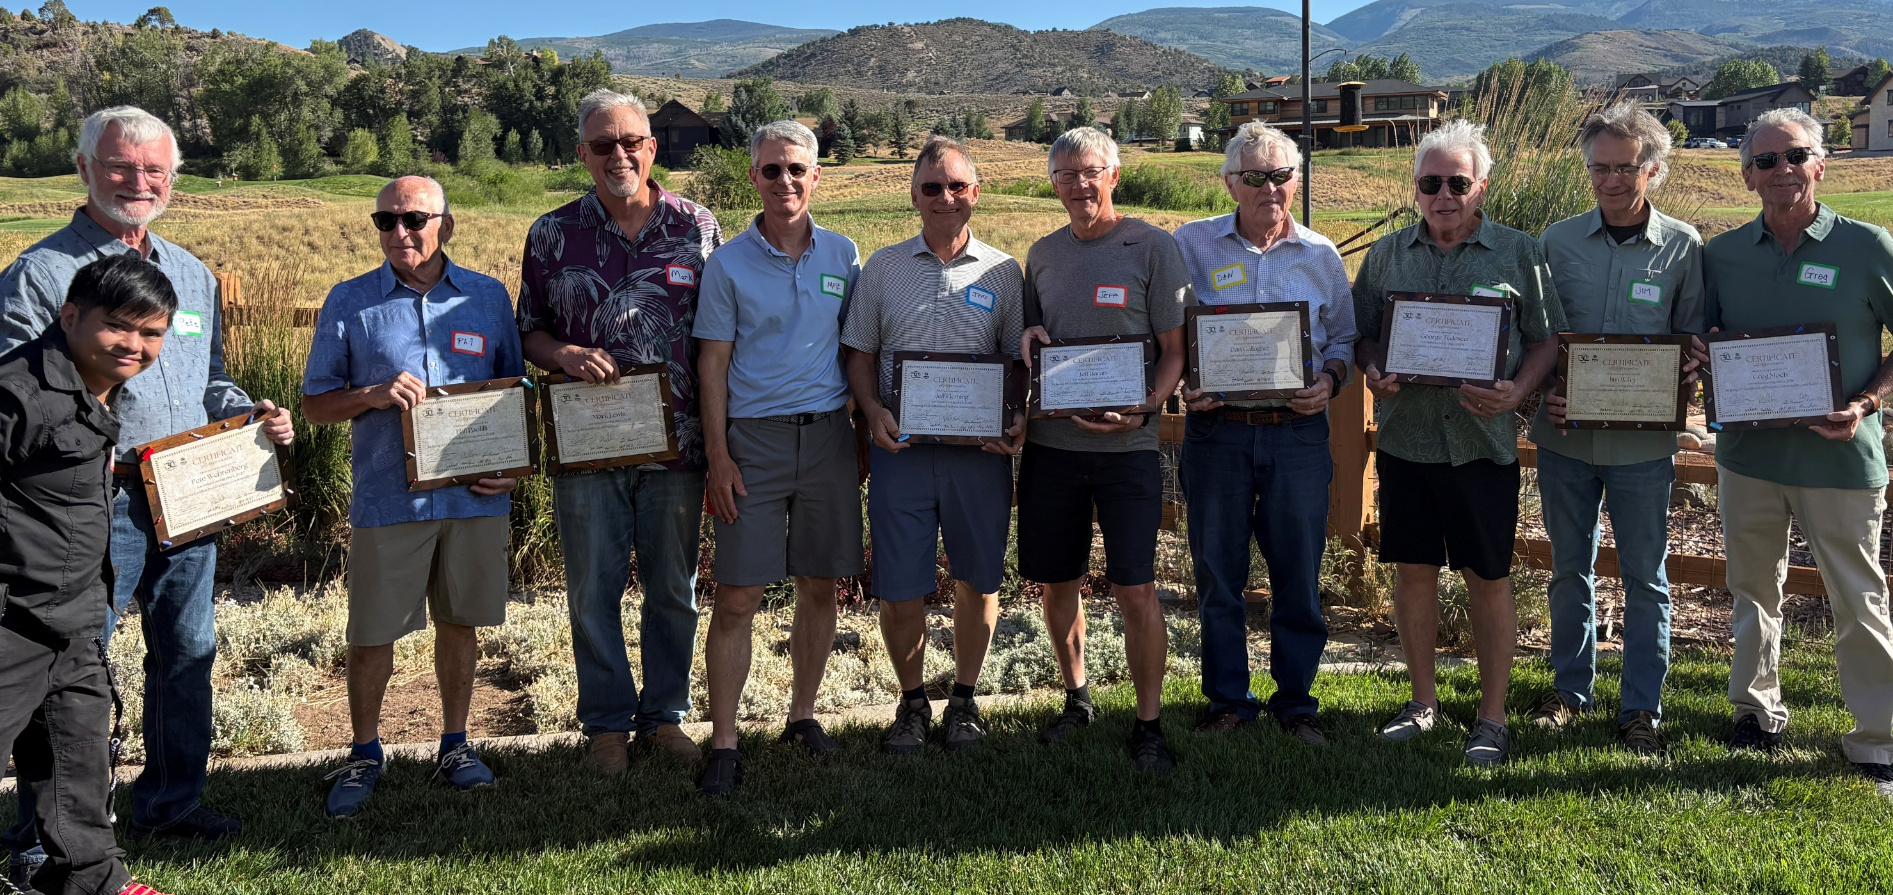
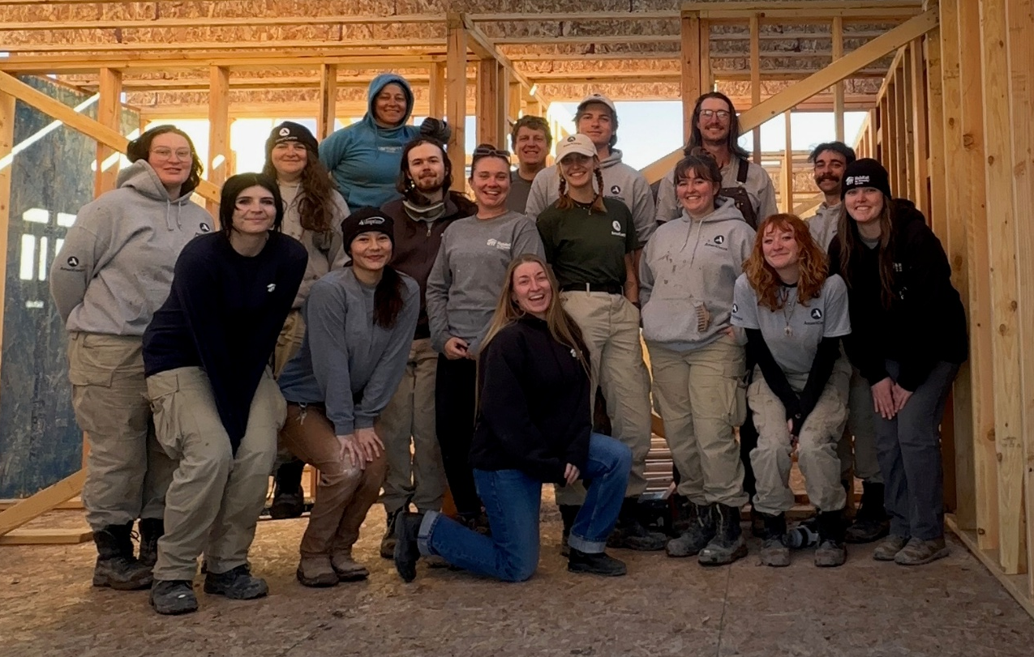
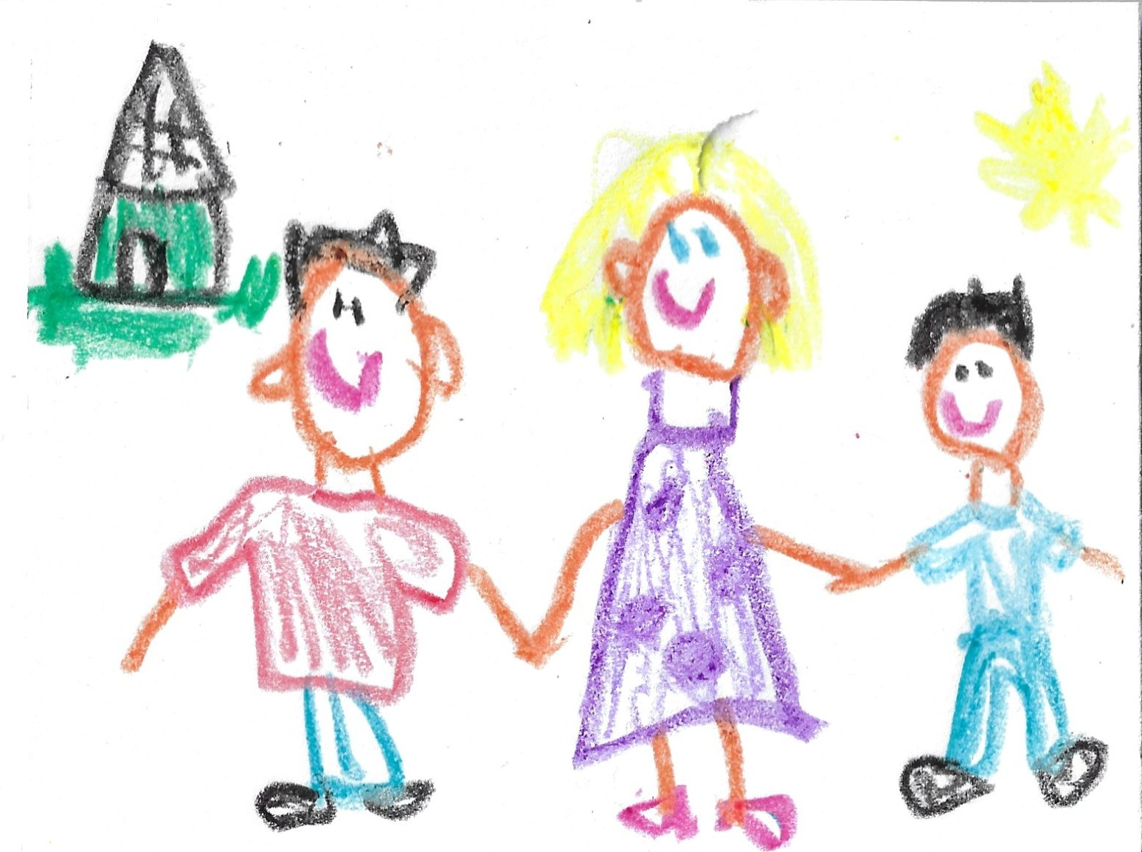
On the Jobsite
2025 BUSY WITH VOLUNTEERS
2800 HOURS CAME FROM “THE REGULARS,” A GROUP OF LOCAL RETIREES THAT VOLUNTEERS EVERY WEDNESDAY
Regulars Group Celebrating Many Years of Service
8 NCCC TEAM MEMBERS CONTRIBUTED OVER
2000 VOLUNTEER HOURS ON THE PHASE 11 HOMES
NCCC Team on Final Day at Stratton Flats
14,064 VOLUNTEER HRS SAVED HABITAT OVER
$545,000 IN JUST 2025 ALONE!
Habitat for Humanity Vail Valley | 970.748.6718
Construction | 970.748.6718 ext. 305
Habitat ReStore | 970.328.1119
construction@habitatvailvalley.org

Slide 3

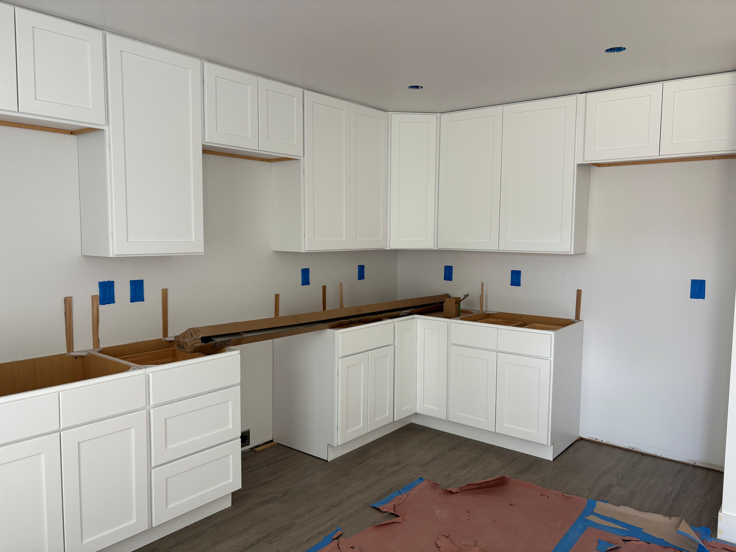
On the Jobsite
TOWN OF GYPSUM APPROVES IK BAR
IK Bar RFP Requests:
Framing
Insulation
Drywall
Flooring
Countertops
Exterior Painting
Asphalt Paving
Road Striping
Gutter
Irrigation
Please visit our website to receive more info!
https://habitatvailvalley.org/get-involved/subcontractor-volunteer-work/
In December, the IK Bar townhome project gained approvals at the Town of Gypsum Town Council for the major plat amendment and rezoning applications. This means the parcel where the townhomes will be located can now be conveyed from Eagle County School District to Habitat. The team is eager to start work on the project and hopes to break ground early next year.
PHASE 11 IN FINISHING STAGES
Through the end of 2025, the team continued work on the Phase 11 homes. Finish carpentry, flooring, and painting occurred in BLDG 12. The final building, BLDG 11, completed rough-in, passing rough framing, mechanical, electrical and plumbing inspection before the holidays. Early this year, the insulators and drywallers will be finishing up work so our team can get in to all of the buildings wrapped up and ready for homeowners!
January Volunteer
Help Requests:
Technical:
Finish (Trim) Carpentry
Non-Technical:
Priming/Painting
Spackling/Caulking
Please visit our website to sign up!
https://habitatvailvalley.org/get-involved/volunteer/
Bldg. 13 cabinets installed and ready for countertops
Habitat for Humanity Vail Valley | 970.748.6718
Construction | 970.748.6718 ext. 305
Habitat ReStore | 970.328.1119
construction@habitatvailvalley.org

Slide 4

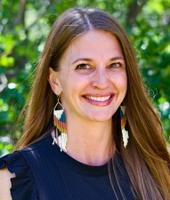
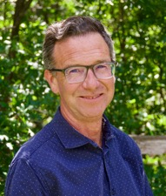


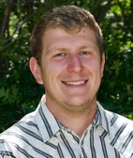
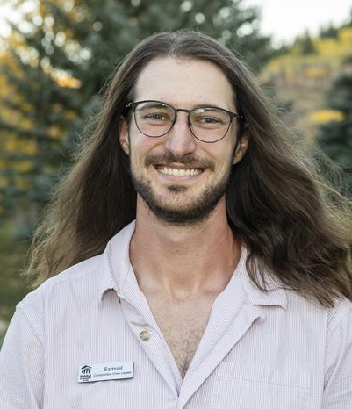




Meet the Team that Builds Homes
Emily Peyton
VP of Operations
Doug Amberg
Director of Construction
Kelsie McKenna
Project Manager
Cassie Scales
Volunteer + HR Coordinator
Greg Bettis
Superintendent
Sam Farrell
Construction Crew Leader
CAMERA SHY
Valencia Urbaniak
AmeriCorps Construction Crew Leader
Henry Martin
CareerWise Construction Crew Leader
Jaeda Roberts
AmeriCorps Construction Crew Leader
Keara Mulrooney
AmeriCorps Construction Crew Leader
Elsie Gothman
Construction Crew Leader
Join our Team. Learn about our mission, and even more at:
www.habitatvailvalley.org

